Slide 1

Sneaker Price & Demand Analysis
StockX Dataset - Data Analytics & Visualization Project

Slide 2



Market Relevance
Growing Industry
Fashion + Investment
Pricing Insights
The sneaker resale market has grown to $6 billion globally, with StockX leading as a premier marketplace for authenticated sneaker trading.
Sneakers have become alternative investments, with some rare releases appreciating 1000%+ in value, creating new opportunities for collectors and resellers.
Data-driven pricing analysis helps buyers make informed decisions, enables resellers to optimize profits, and guides brands in release strategies.

Slide 3

Dataset Selection
Kaggle StockX Sneaker Dataset
Source: Comprehensive resale transaction data from StockX marketplace
Scale: 99,956 authenticated transactions across multiple brands and regions
Coverage: Global buyer regions, diverse price points, multiple release periods
Why this dataset? Large sample size, clean structure, and rich variables make it ideal for comprehensive demand and pricing trend analysis.

Slide 4
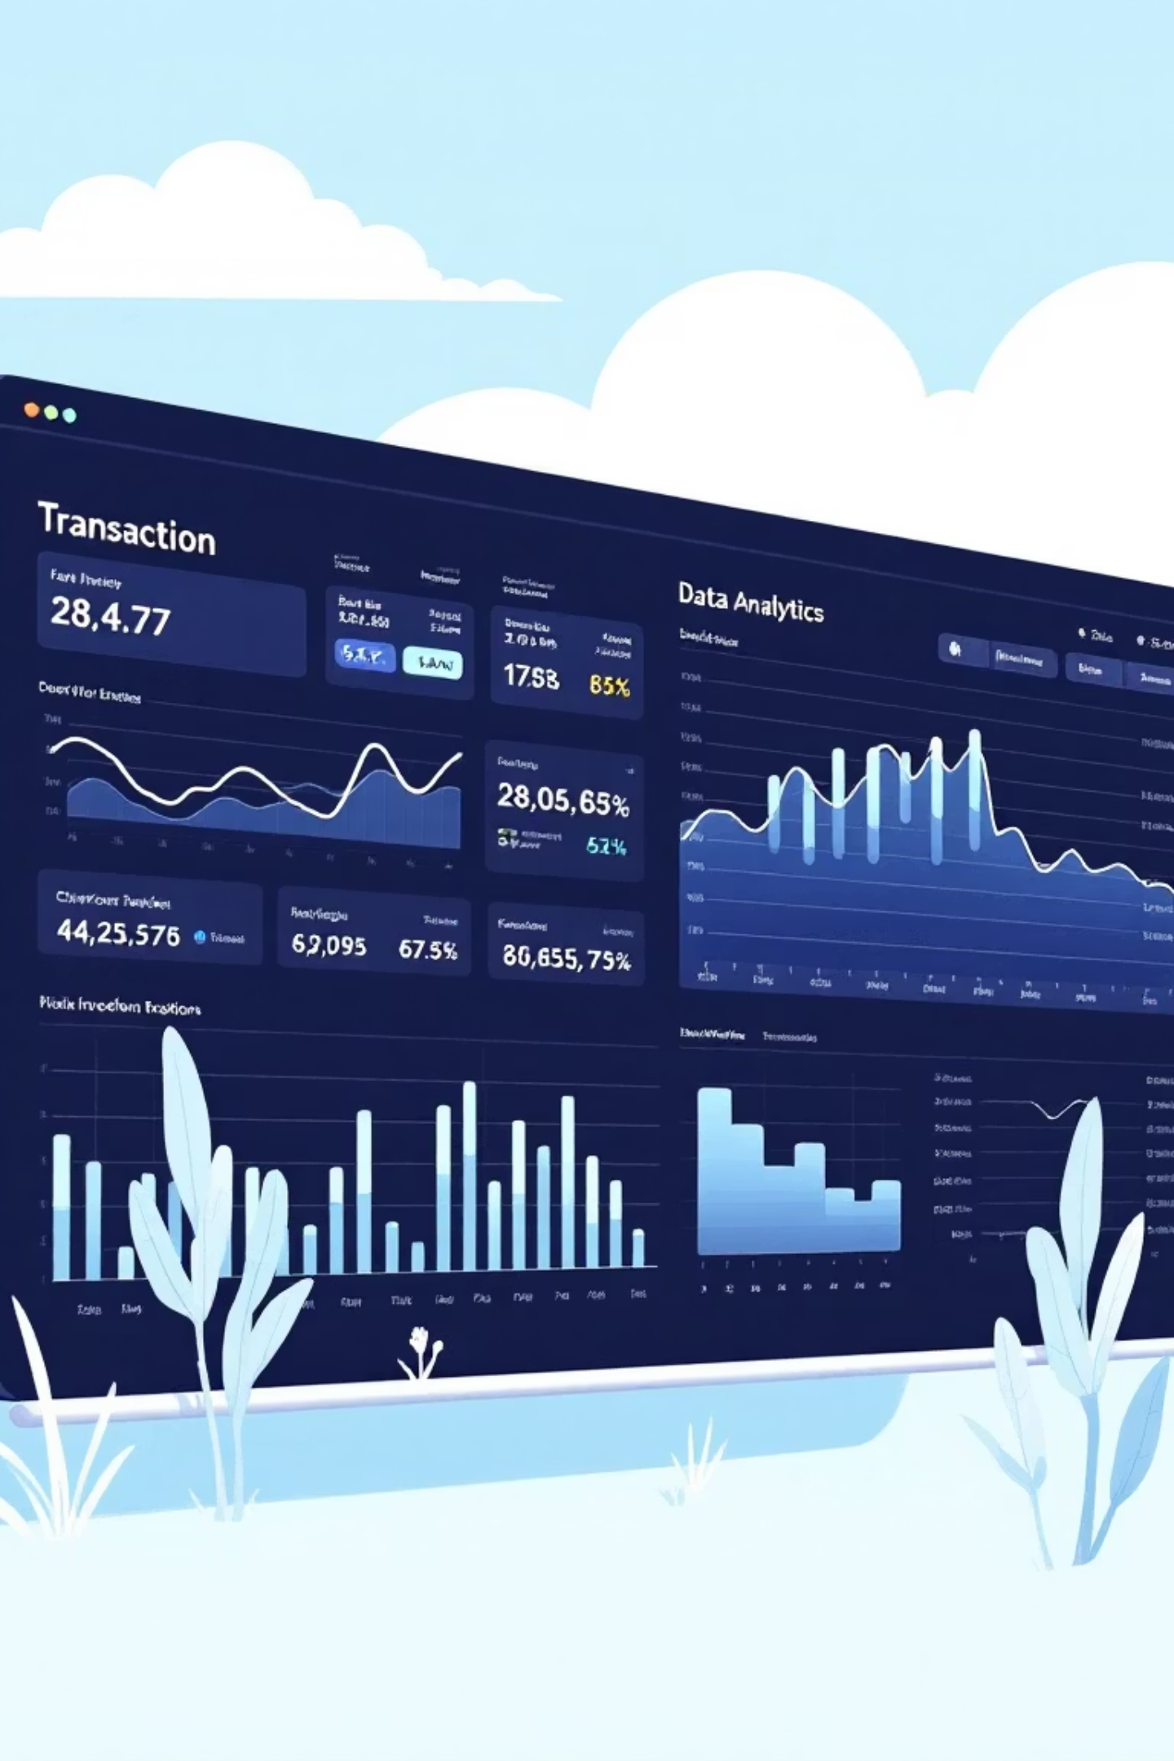
Dataset Metadata Overview
99,956
8
0
Total Transactions
Core Variables
Missing Values
Essential data points for thorough analysis
Complete dataset with no data gaps
Comprehensive sample of sneaker resale activity

Slide 5
Key Variables Breakdown
1
2
Temporal Data
Product Information
Order Date (datetime)
Brand (string)
Release Date (datetime)
Sneaker Name (string)
Shoe Size (float)
3
4
Financial Metrics
Geographic Data
Sale Price (float) - resale value
Buyer Region (string)
Retail Price (int) - original MSRP

Slide 6



Analysis Objectives
Pricing Dynamics
Compare retail vs resale prices to identify profit margins and premium patterns across different brands and releases.
Demand Patterns
Analyze popular brands, models, and seasonal trends to understand consumer preferences and market cycles.
Buyer Behavior
Examine regional purchasing patterns and size distributions to identify market segments and consumer demographics.

Slide 7
Technical Tools & Approach
Python Ecosystem
Leveraging numpy and pandas for efficient data manipulation and statistical analysis of large transaction datasets.
Visualization Libraries
Using seaborn and matplotlib to create compelling charts that reveal pricing trends, demand patterns, and market insights.

Slide 8
Data Preprocessing Steps
01
02
Data Quality Assessment
Type Conversion
Validated complete dataset with zero missing values across all 99,956 transactions.
Converted object columns to proper datetime format for temporal analysis capabilities.
03
04
Duplicate Removal
Dataset Optimization
Identified and removed duplicate transactions to ensure analytical accuracy.
Cleaned and structured data for efficient analysis and visualization workflows.

Slide 9
Feature Engineering
New Variables Created
Order Month & Year
Extracted from order date to analyze seasonal demand patterns and yearly growth trends.
Profit Margin
Calculated as Sale Price minus Retail Price to measure resale value appreciation and investment potential.
Purpose: Enable comprehensive seasonal analysis, yearly trend identification, and profitability assessment across different sneaker categories.

